Slide 1


Day – 28 : Joins in SQL
Course created by Satish Dhawale | www.skillcourse.in

Slide 2
Types of SQL Joins
INNER JOIN: Retrieves records with matching values in both tables.
LEFT JOIN (LEFT OUTER JOIN): Retrieves all records from the left table and matching records from the right table. Non-matching records in the right table result in NULL.
RIGHT JOIN (RIGHT OUTER JOIN): Retrieves all records from the right table and matching records from the left table. Non-matching records in the left table result in NULL.
FULL JOIN (FULL OUTER JOIN): Retrieves all records from both tables, with NULL for non-matching rows in either table.
CROSS JOIN: Combines all rows from both tables, resulting in a Cartesian product.
SELF JOIN: Joins a table to itself.

Slide 3
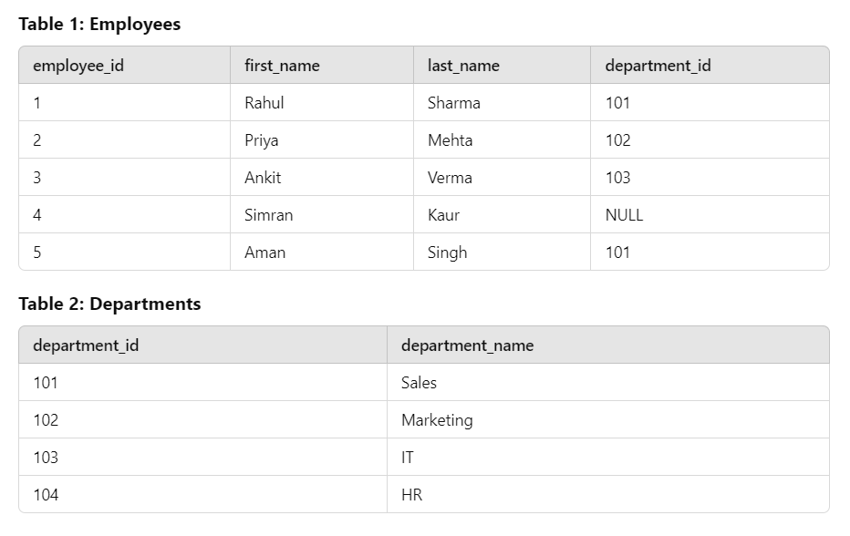
To explain joins, we’ll create two tables: Employees3 and Departments.

Slide 4
-- Create Employees3 Table
CREATE TABLE Employees3 (
employee_id SERIAL PRIMARY KEY,
first_name VARCHAR(50),
last_name VARCHAR(50),
department_id INT
);
-- Insert Data into Employees3
INSERT INTO Employees3 (first_name, last_name, department_id)
VALUES
('Rahul', 'Sharma', 101),
('Priya', 'Mehta', 102),
('Ankit', 'Verma', 103),
('Simran', 'Kaur', NULL),
('Aman', 'Singh', 101);

Slide 5
-- Create Departments Table
CREATE TABLE Departments (
department_id INT PRIMARY KEY,
department_name VARCHAR(50)
);
-- Insert Data into Departments
INSERT INTO Departments (department_id, department_name)
VALUES
(101, 'Sales'),
(102, 'Marketing'),
(103, 'IT'),
(104, 'HR');

Slide 6
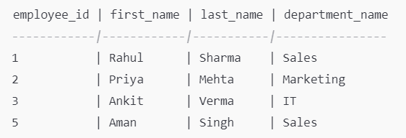
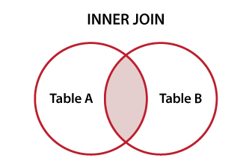
1. INNER JOIN - Retrieve Employees3 and their department names where a match exists.
SELECT
e.employee_id,
e.first_name,
e.last_name,
d.department_name
FROM
Employees3 e
INNER JOIN
Departments d
ON
e.department_id = d.department_id;
OUTPUT →

Slide 7
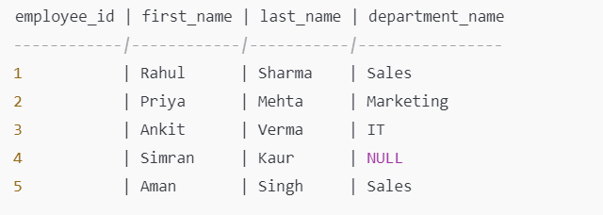
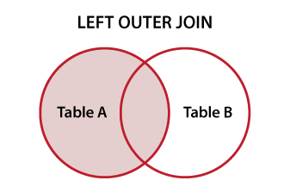
2. LEFT JOIN - Retrieve all Employees3 and their department names, including those without a department.
SELECT
e.employee_id,
e.first_name,
e.last_name,
d.department_name
FROM
Employees3 e
LEFT JOIN
Departments d
ON
e.department_id = d.department_id;
OUTPUT →

Slide 8
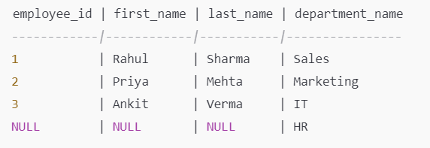
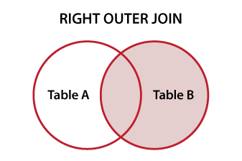
3. RIGHT JOIN - Retrieve all departments and the Employees3 working in them, including departments without
SELECT
e.employee_id,
e.first_name,
e.last_name,
d.department_name
FROM
Employees3 e
RIGHT JOIN
Departments d
ON
e.department_id = d.department_id;
OUTPUT →

